Slide 1
Chapter 14
Software evolution

Slide 2
Objectives
To explain why change is inevitable if software systems are to remain useful
To discuss software maintenance and maintenance cost factors
To describe the processes involved in software evolution
To discuss an approach to assessing evolution strategies for legacy systems

Slide 3
Topics covered
Program evolution
Software maintenance
Evolution processes
Legacy system evolution

Slide 4
Software change
Software change is inevitable
  New requirements emerge when the software is used;
  The business environment changes;
  Errors must be repaired;
  New computers and equipment is added to the system;
  The performance or reliability of the system may have to be improved
Change makes software evolution necessary

Slide 5
Importance of evolution
Organisations have huge investments in their software systems - they are critical business assets.
To maintain the value of these assets to the business, they must be changed and updated.
The majority of the software budget in large companies is devoted to evolving existing software rather than developing new software.

Slide 6
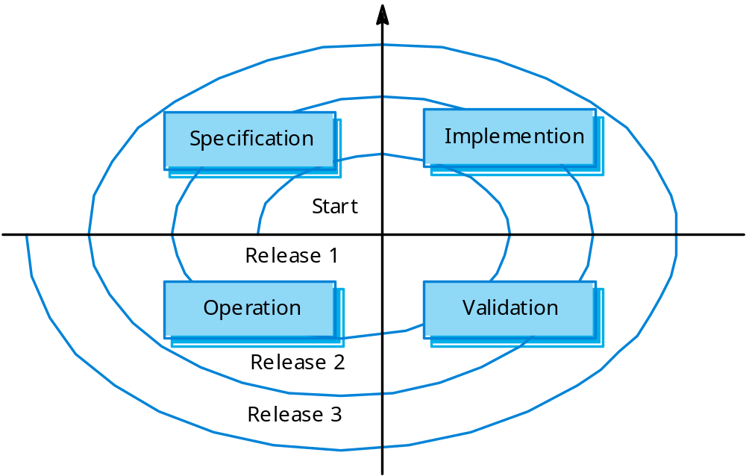
Spiral model of evolution

Slide 7
Evolution and maintenance modes
Evolution: a single organisation is responsible for both developing and changing the software.
Maintenance: developing and changing the software by distinct organisation
Most generic software is evolution mode; custom software is maintenance one.
Evolution and maintenance are different in process activities.

Slide 8
Types of maintenance
Corrective: to repair software faults
  Changing a system to correct deficiencies in the way meets its requirements.
Adaptive: to adapt software to a different operating environment
  Changing a system so that it operates in a different environment (computer, OS, etc.) from its initial implementation.
Perfective: to add to or modify the system’s functionality
  Modifying the system to satisfy new requirements.

Slide 9
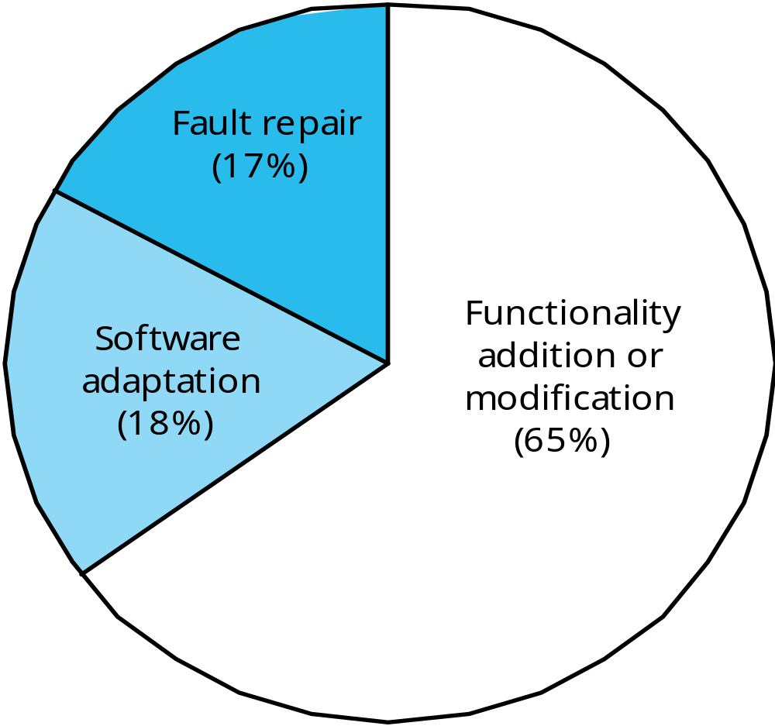
Distribution of maintenance effort

Slide 10
Maintenance costs
Usually greater than development costs depending on the application.
It is usually cost-effective to invest effort in designing and implementing a system to reduce maintenance costs.

Slide 11
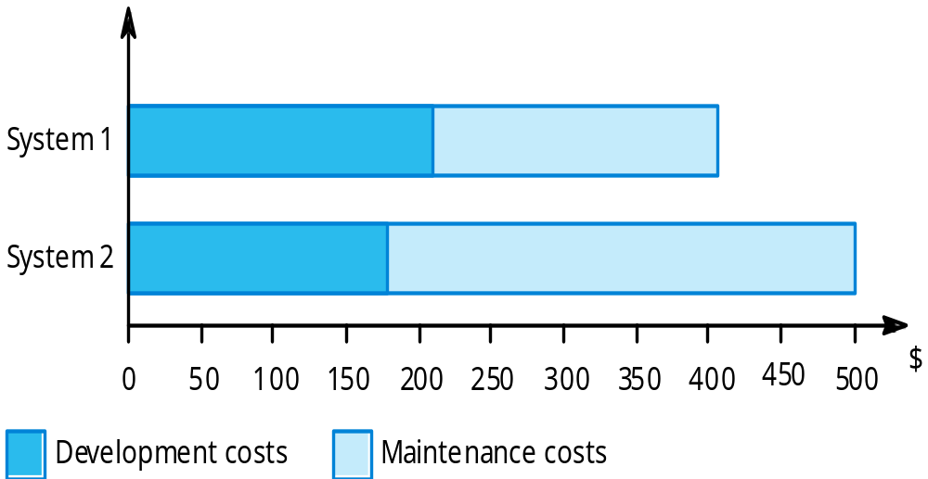
Development/maintenance costs

Slide 12
Maintenance cost factors
Team stability
  Maintenance costs are reduced if the same staff are involved with them for some time.
Contractual responsibility
  The developers of a system may have no contractual responsibility for maintenance so there is no incentive to design for future change.
Staff skills
  Maintenance staff are often inexperienced and have limited domain knowledge.
Program age and structure
  As programs age, their structure is degraded and they become harder to understand and change.

Slide 13
Maintenance prediction
Maintenance prediction is concerned with assessing which parts of the system may cause problems and have high maintenance costs
  Change acceptance depends on the maintainability of the components affected by the change;
  Implementing changes degrades the system and reduces its maintainability;
  Maintenance costs depend on the number of changes and costs of change depend on maintainability.

Slide 14
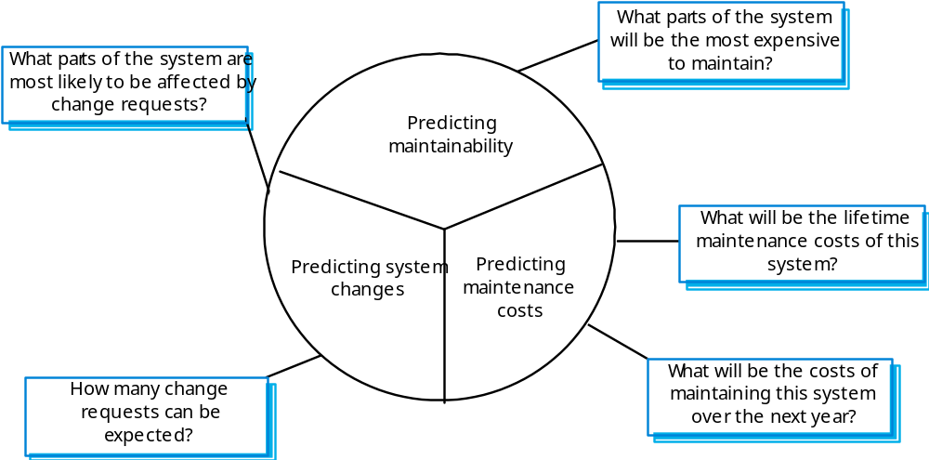
Maintenance prediction

Slide 15
Change prediction
Predicting the number of changes requires and understanding of the relationships between a system and its environment.
Tightly coupled systems require changes whenever the environment is changed.
Factors influencing this relationship are
  Number and complexity of system interfaces;
  Number of inherently volatile system requirements;
  The business processes where the system is used.

Slide 16
Complexity metrics
Predictions of maintainability can be made by assessing the complexity of system components.
Studies have shown that most maintenance effort is spent on a relatively small number of system components.
Complexity depends on
  Complexity of control structures;
  Complexity of data structures;
  Object, method (procedure) and module size.

Slide 17
Evolution processes
Evolution processes depend on
  The type of software being maintained;
  The development processes used;
  The skills and experience of the people involved.
Proposals for change are the driver for system evolution. Change identification and evolution continue throughout the system lifetime.

Slide 18
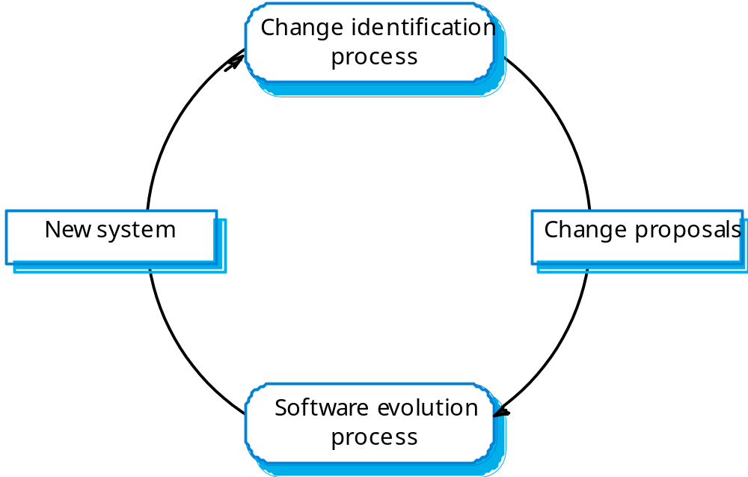
Change identification and evolution

Slide 19
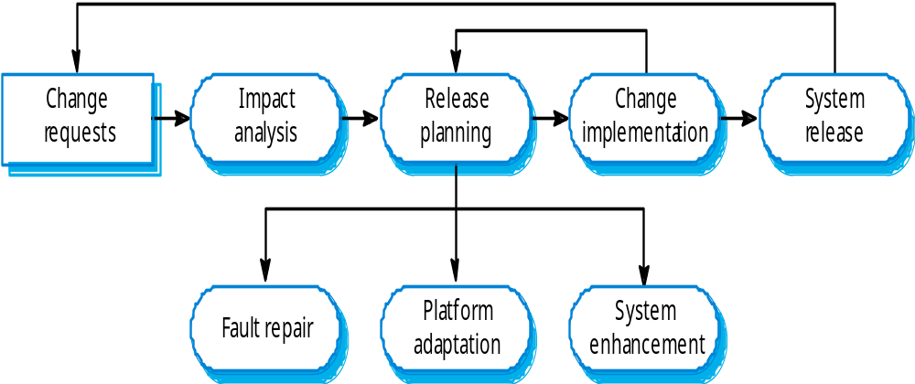
The system evolution process

Slide 20
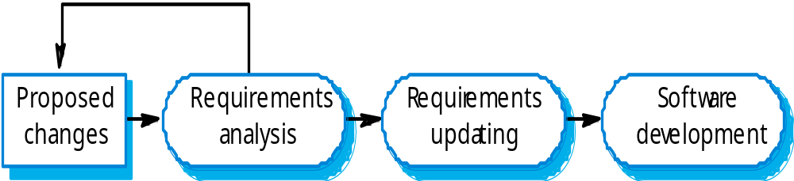
Change implementation

Slide 21
Urgent change requests
Urgent changes may have to be implemented without going through all stages of the software engineering process
  If a serious system fault has to be repaired;
  If changes to the system’s environment (e.g. an OS upgrade) have unexpected effects;
  If there are business changes that require a very rapid response (e.g. the release of a competing product).

Slide 22
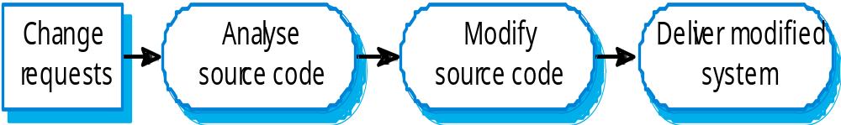
Emergency repair

Slide 23
System re-engineering
Re-structuring or re-writing part or all of a
legacy system without changing its
functionality.
Applicable where some but not all sub-systems
of a larger system require frequent
maintenance.
Re-engineering involves adding effort to make
them easier to maintain. The system may be re-structured and re-documented.

Slide 24
Advantages of reengineering
Reduced risk
  There is a high risk in new software development. There may be development problems, staffing problems and specification problems.
Reduced cost
  The cost of re-engineering is often significantly less than the costs of developing new software.
Re-developing new system is also called forward engineering.

Slide 25
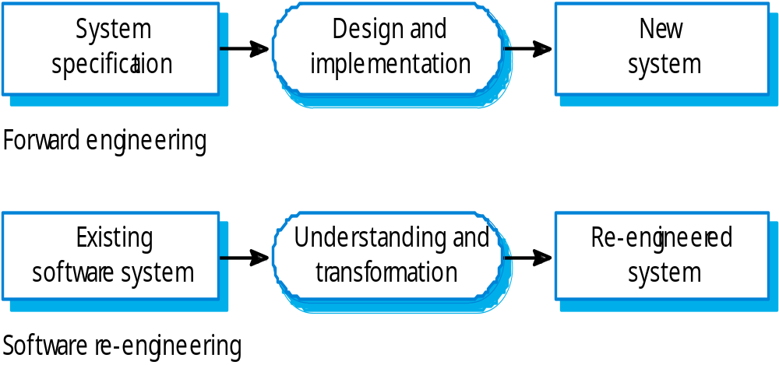
Forward and re-engineering distinction: start piont

Slide 26
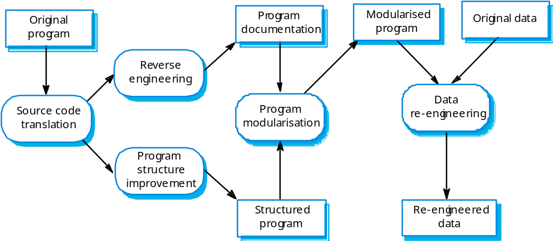
The re-engineering process

Slide 27
Reengineering process activities
Source code translation
  Convert code to a new language.
Reverse engineering
  Analyse the program to understand it;
Program structure improvement
  Restructure automatically for understandability;
Program modularisation
  Reorganise the program structure;
Data reengineering
  Clean-up and restructure system data.

Slide 28
Reengineering cost factors
The quality of the software to be reengineered.
The tool support available for reengineering.
The extent of the data conversion which is required.
The availability of expert staff for reengineering.
  This can be a problem with old systems based on technology that is no longer widely used.

Slide 29
Legacy system evolution
Organisations that rely on legacy systems must choose a strategy for evolving these systems
  Scrap the system completely and modify business processes so that it is no longer required;
  Continue maintaining the system;
  Transform the system by re-engineering to improve its maintainability;
  Replace the system with a new system.
The strategy chosen should depend on the system quality and its business value.

Slide 30
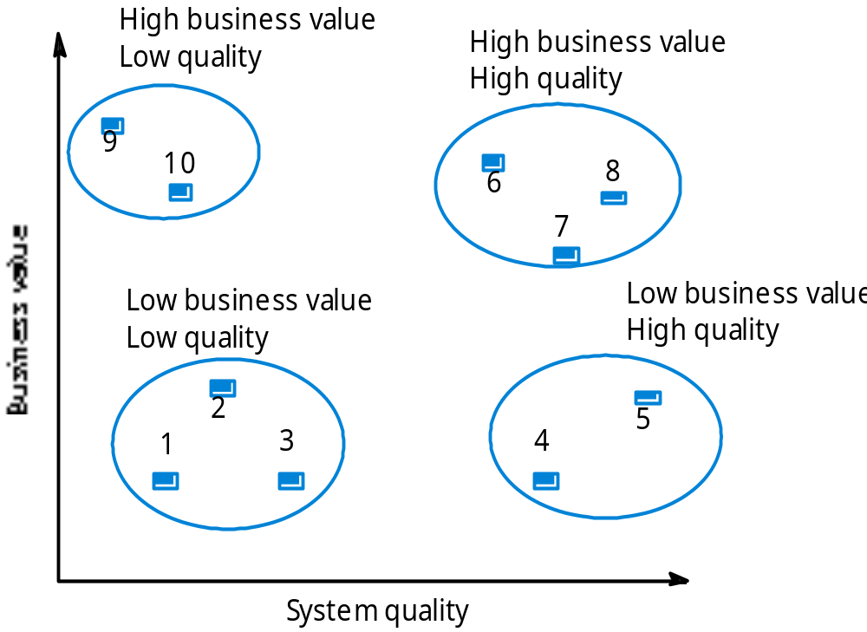
System quality and business value
Business
value
System quality

Slide 31
Legacy system categories
Low quality, low business value
  These systems should be scrapped.
Low-quality, high-business value
  These make an important business contribution but are expensive to maintain. Should be re-engineered or replaced if a suitable system is available.
High-quality, low-business value
  Replace with COTS, scrap completely or maintain.
High-quality, high business value
  Continue in operation using normal system maintenance.

Slide 32
Business value assessment
Assessment should take different viewpoints into account
  System end-users;
  Business customers;
  Line managers;
  IT managers;
  Senior managers.
Interview different stakeholders and collate results.

Slide 33
System quality assessment
Business process assessment
  How well does the business process support the current goals of the business?
Environment assessment
  How effective is the system’s environment and how expensive is it to maintain?
Application assessment
  What is the quality of the application software system?

Slide 34
Business process assessment
Use a viewpoint-oriented approach and seek answers from system stakeholders
  Is there a defined process model and is it followed?
  Do different parts of the organisation use different processes for the same function?
  How has the process been adapted?
  What are the relationships with other business processes and are these necessary?
  Is the process effectively supported by the legacy application software?

Slide 35
System measurement
You may collect quantitative data to make an assessment of the quality of the application system
  The number of system change requests;
  The number of different user interfaces used by the system;
  The volume of data used by the system.

Slide 36
Key points
Software development and evolution should be a single iterative process.
Lehman’s Laws describe a number of insights into system evolution.
Three types of maintenance are bug fixing, modifying software for a new environment and implementing new requirements.
For custom systems, maintenance costs usually exceed development costs.

Slide 37
Key points
The process of evolution is driven by requests for changes from system stakeholders.
Software re-engineering is concerned with re-structuring and re-documenting software to make it easier to change.
The business value of a legacy system and its quality should determine the evolution strategy that is used.

